Slide 1
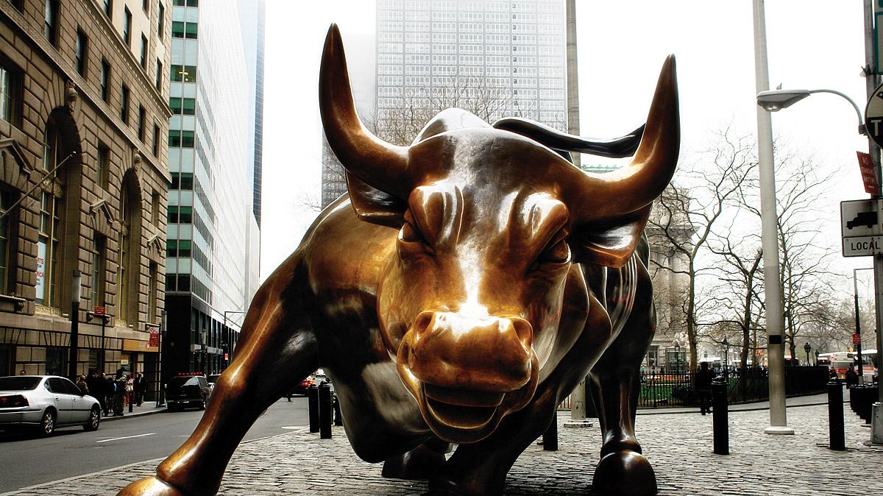
Predicting Market Reaction to News
Team 02: Milind, Suvir, Kokila, Raghav, Chan, Vishal
4/25/2017

Slide 2

Agenda
Objective
Data sources & Inputs
Data preprocessing
Modeling & Clustering
Results
Recommendation

Slide 3
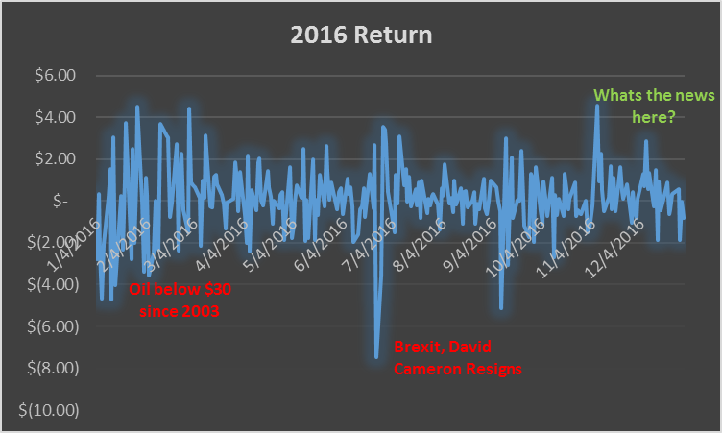
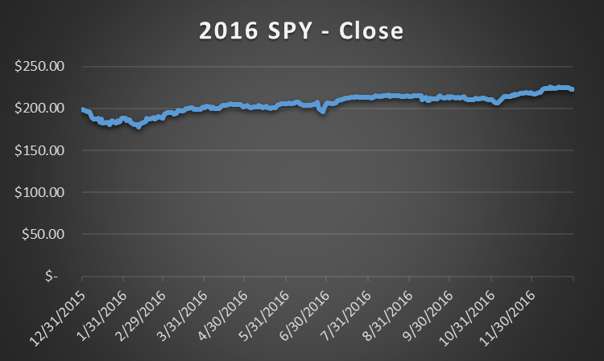
Objective
Analyze Top 25 news feed of the day to assess sentiment & pronounced keywords. Model its relationship with the market behavior. Predict returns during day trade. Recommend long or short strategy.
Go long on the morning of 11/7/2016
Short on day open of 6/24/2016
Short on day open of 1/23/2016

Slide 4
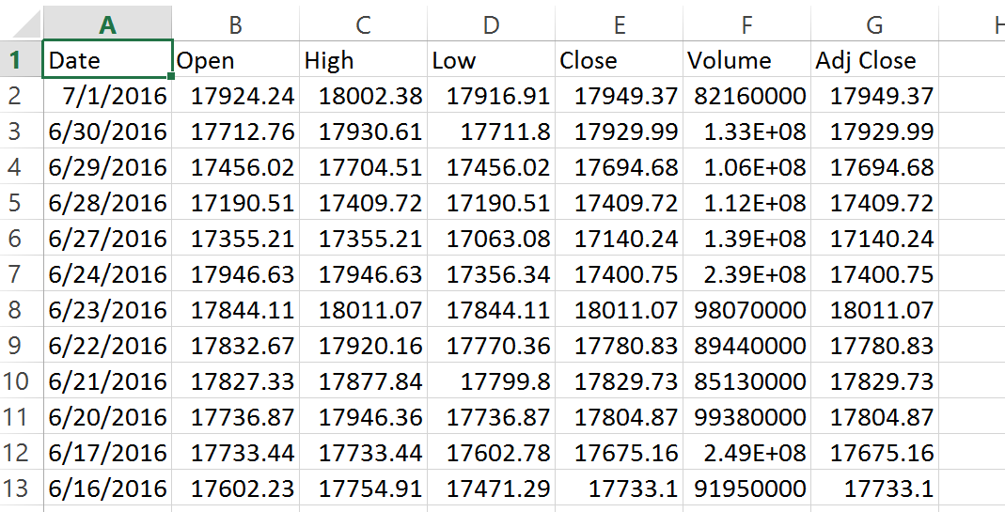
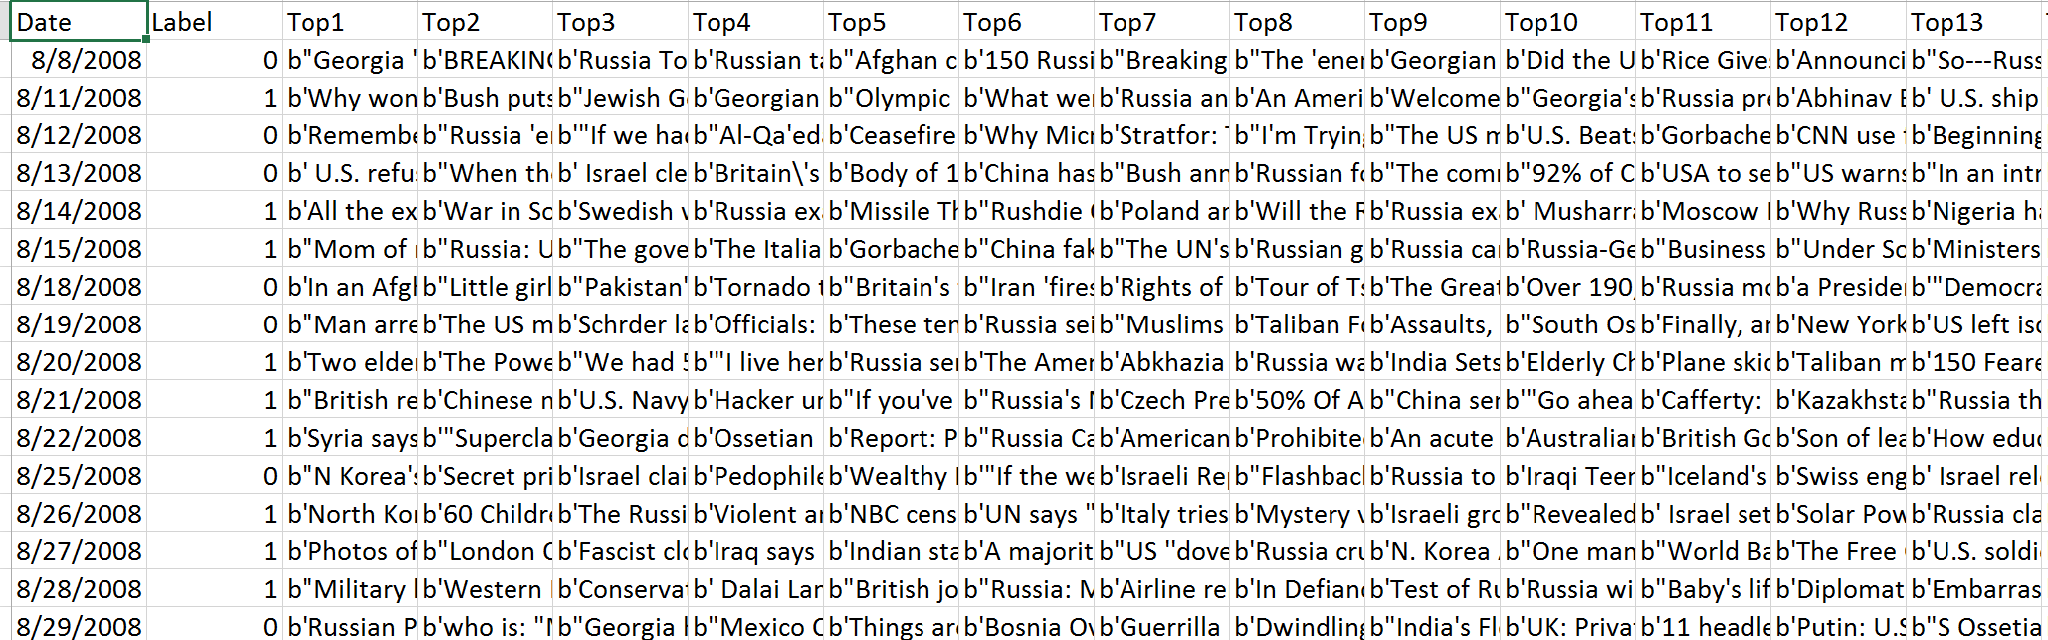
Data sources & Inputs
Data sources：
Kaggle
News Feed
Yahoo Finance
news

Slide 5

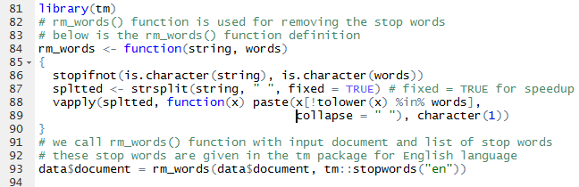
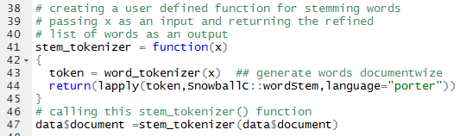
Data Preprocessing
1. Missing Values
2. Data Transformation
Transformation using xts
Date format conversion
Stop words removal
Stemming the keywords

Slide 6

Modeling--Packages
tm: performs the text mining operations
SnowballC: implements Porter’s word stemming algorithm for collapsing words to a common root
text2vec: API for implementing text analysis and natural language processing (NLP)
LDAvis: interactive model visualization
topicmodels: provides an interface to the latent dirichlet allocation (LDA) models and correlated topic models (CTM)
xts: doing the conversion of the date format
tseries: doing the time series analysis and computational finance

Slide 7
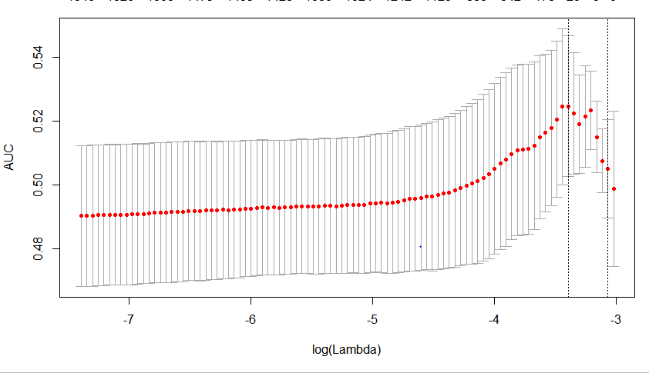
Modeling: regression
Cross validation feature is used and model is fitted, however the results are not promising as we are able to achieve AUC of 0.53 which is little above the baseline.

Slide 8
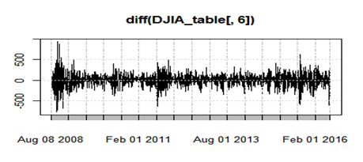
Time series analysis

Slide 9
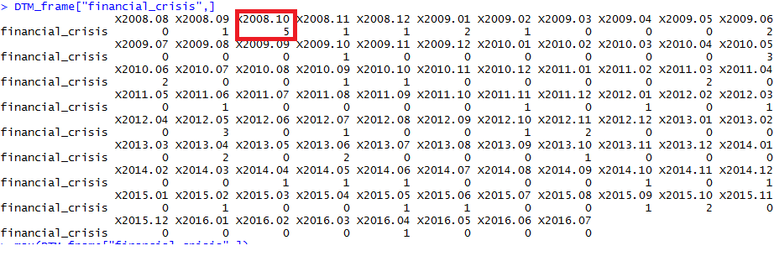
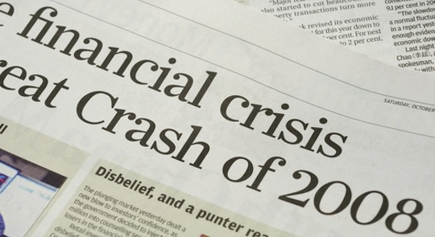
FINDINGS: FINANCIAL CRISIS IN 2008

Slide 10
Time series analysis

Slide 11
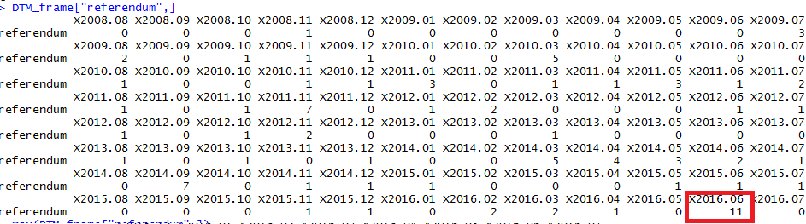

FINDINGS: BREXIT

Slide 12
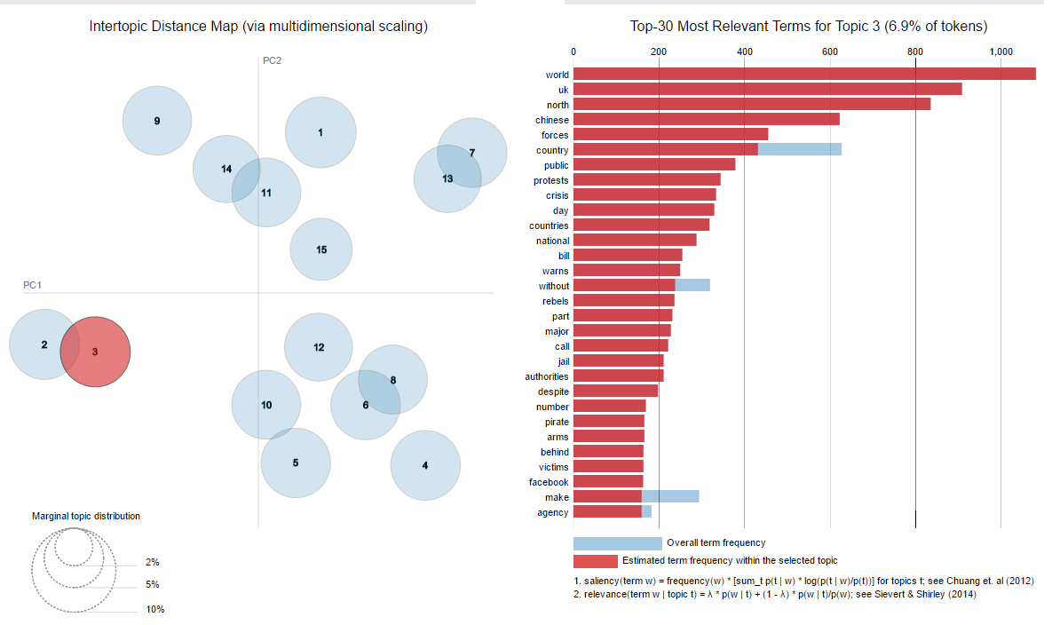
Results: LDAvis plot

Slide 13
Recommendation
As bad news is better correlated to market movements than good news, we trigger an automated trade to short based on the score of the prevailing sentiment assessment across the pronounced keywords.
Further inflate returns by going long on the put option at the day’s open to utilize leverage.
Build a model that learns and constantly accepts feedback on news to improve scoring. This might be a moving target – new keywords might become relevant and sentiment effect could wax or wane.
We analyzed the effect on SPYDER (S&P 500) and DIA (Dow jones Industrial Average) ETFs. We suggest exploring securities where correlation to news is more pronounced – these could be currencies, oil or derivatives on these securities.

Slide 14


